Slide 1
Hackathon Case Study
Super Hack Team
DSML

Slide 2
Code Quality Classification
Business Context:
Imagine you are a lead data scientist in charge of a critical project within your organization. The project involves developing a complex software system that is integral to the success of a new product launch. As the project progresses, there is a growing concern about the overall quality of the software codebase, and management has decided to conduct a thorough software quality assessment. The development team has been diligently working on project, and the codebase has evolved over time. However, as the project is reaching a crucial milestone, there is a need to ensure that the software meets the highest quality standards to minimize the risk of defects and ensure long-term maintainability. To initiate the software quality assessment, the team has gathered a dataset containing various metrics related to the software's complexity, size, structure, and potential defects. Your task as the lead data scientist is to leverage this dataset to perform a comprehensive software quality assessment. The goal is to analyse the provided metrics and identify key insights regarding the overall quality of the software. Your findings will be crucial in making informed decisions about areas that need improvement, potential risks, and the overall health of the software codebase.
In-scope:
Analysis the train data set and review all data attributes as provided in the train data set.
Appropriate data preparation including data describe.
Clean and preprocess the dataset, handling missing values, outliers, and inconsistencies. Perform feature engineering to create new metrics or transform existing ones if necessary. Split the dataset into training and testing sets for model evaluation.
Implement Exploratory Data Analysis (EDA) which includes visualization techniques to identify patterns, trends, and correlations in the data. Identify the most influential metrics that contribute to software quality.
Employ predictive modelling to supervise learning algorithms to predict the likelihood of defects based on the software metrics. Experiment with various models, such as logistic regression, decision trees, random forests, or gradient boosting machines.
Predict defects in the test dataset from given excel sheet by applying trained model and calculate the accuracy percentage.

Slide 3
Approaches
Data Preparation and Cleaning:
Load Dataset: Load your dataset from a CSV file into a pandas Data Frame.
Split Features and Target: Separate the dataset into features (X) and the target variable (y). The target variable in this case is defects.
Train-Test Split: Split the dataset into training and testing sets to evaluate the performance of your machine learning model.
Identify Column Types: Identify numerical and categorical columns since they require different preprocessing.
Preprocessing Pipelines: Create separate preprocessing pipelines for numerical and categorical data. For numerical data, missing values are imputed with the mean, and data is scaled using Standard Scaler. For categorical data, missing values are imputed with the most frequent category, and one-hot encoding is applied.
Column Transformer: Combine the preprocessing steps for both numerical and categorical data using Column Transformer.
Apply Preprocessing: Fit the preprocessing pipeline on the training data and transform both the training and testing sets
Exploratory Data Analysis
Generate Correlation Metrix to understand the relationships between numerical features, especially how they relate to defects.
Plotting of distribution of defects, cyclometric complexity, heatmap, feature ,metrics distribution
Based on the correlation matrix and EDA, identify metrics that have a strong relationship with software defects.
Investigate if any metrics, such as complexity or code density, are particularly indicative of defects. This analysis will assist in making informed decisions about improving software quality.
Predictive Modelling and Model evolution:
Employ supervised learning algorithms to predict the likelihood of defects based on the software metrics.
Experiment with various models, such as logistic regression, decision trees, random forests, or gradient boosting machines.
Tune the hyperparameters of the models using techniques like grid search or cross-validation to optimize their performance.
Assess the performance of the trained models using appropriate metrics, such as accuracy, precision, recall, and F1-score.
Conduct cross-validation to ensure the models generalize well to unseen data.

Slide 4
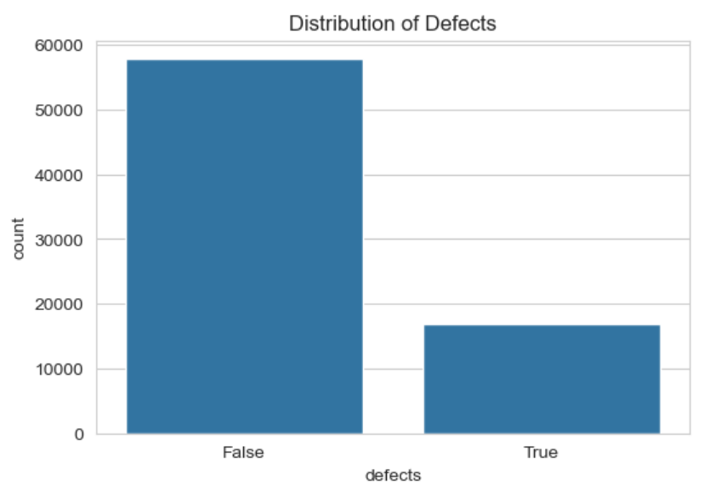
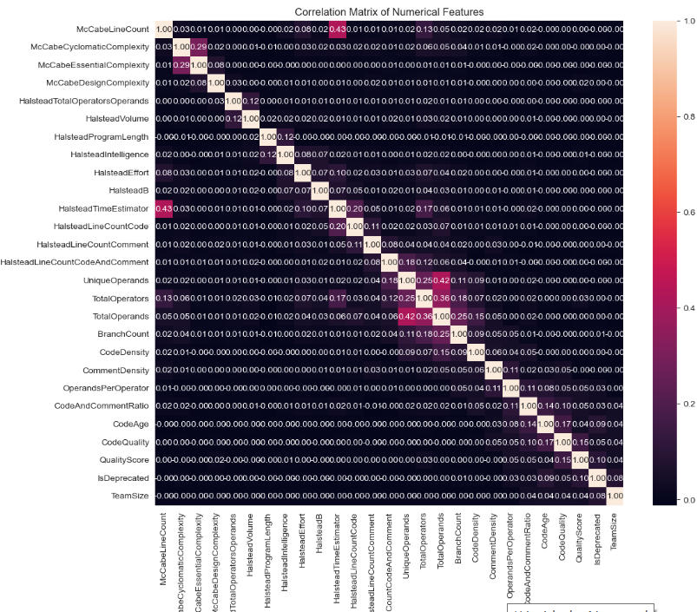
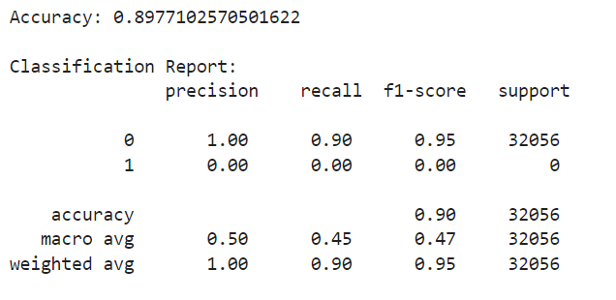
Data Exploratory Analysis and Visualization
Distribution of Defects
Correlation Metrix of Numerical Features
Accuracy Score

